Slide 1
Final Project Presentation
By: Malcolm Darukhanawalla

Slide 2
Business Question 1
Which teams had the highest average scoring margin during regular season games compared to playoff games? Breakdown by season.

Slide 3
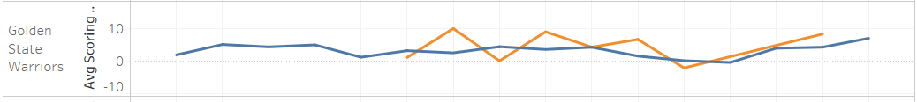
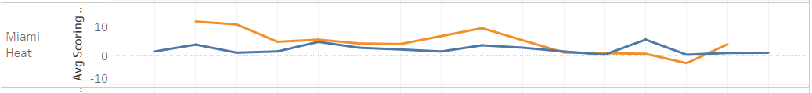
Visualization 1: Average Scoring Margin vs Season

Slide 4
Business Question 2
What percentage of games in a season resulted in the favorite failing to cover the spread? Breakdown by season.

Slide 5
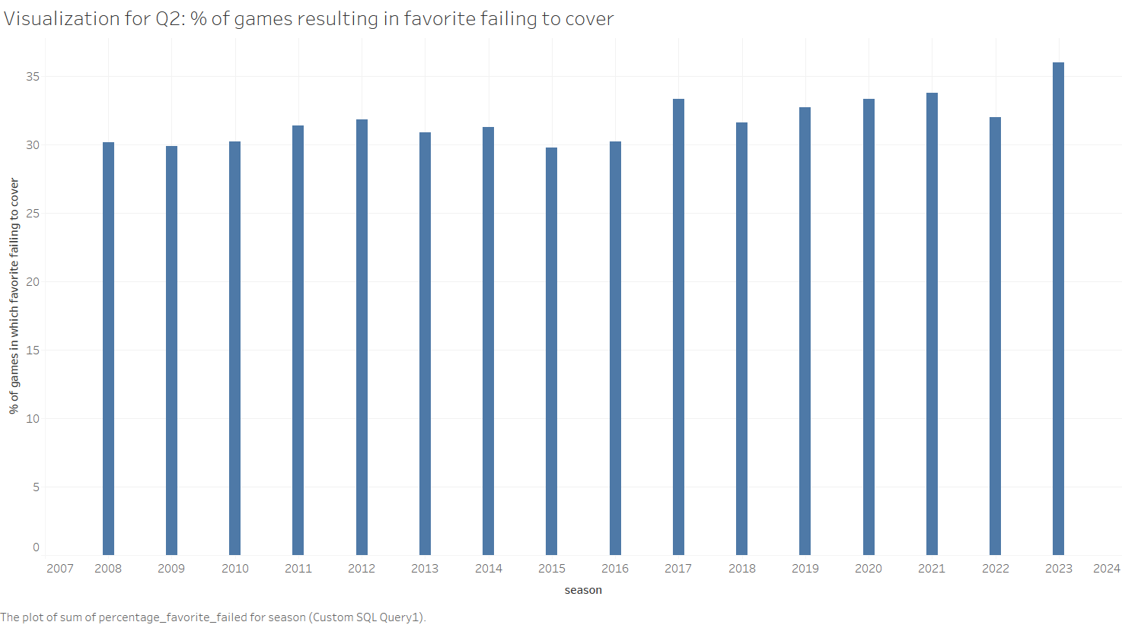

Slide 6
Business Question 3
By team, identify percentage of games where the underdog covered the second half spread but not the full-game spread. Breakdown by season.

Slide 7
Visualization 3: % of Games vs Season

Slide 8
Business Question 4
What is the average point differential games played during the playoffs versus regular-season games? Breakdown by season.

Slide 9
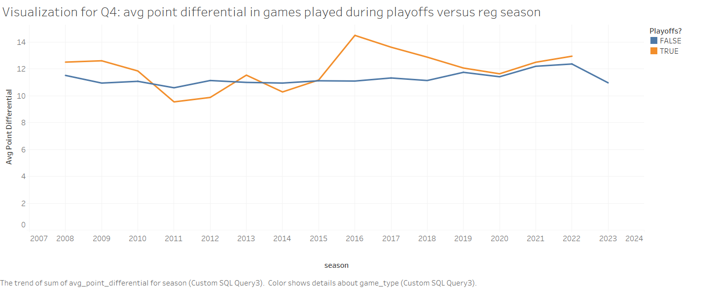

Slide 10
Business Question 5
Determine the top teams with the best performance based on win rates in close games decided by 5 points or fewer in regular season and playoffs. Breakdown by season.

Slide 11
Visualization 5: Win % vs Season

Slide 12
Business Question 6
Calculate the percentage of games where the total score matched exactly with the line. Breakdown by season.

Slide 13
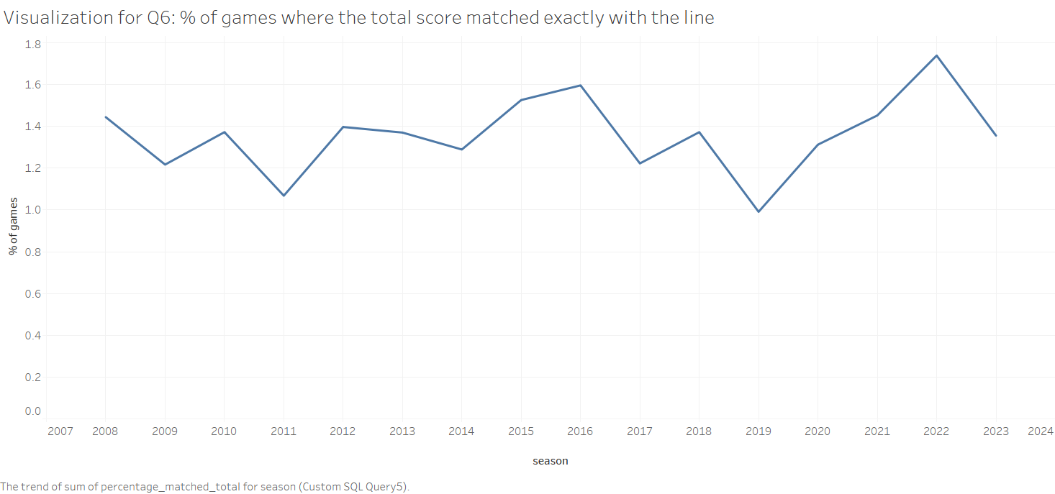

Slide 14
Business Question 7
Which team had the most games where they covered the spread as an underdog per season? Breakdown by season.

Slide 15
Visualization 7: # of Games vs Season

Slide 16
Business Question 8
By season and team, identify how often second half betting results differed from full game betting results.

Slide 17
Visualization 8: # of Games vs Season

Slide 18
Business Question 9
Is there a statistically significant difference in average home scores versus away scores during the playoffs, and where?

Slide 19
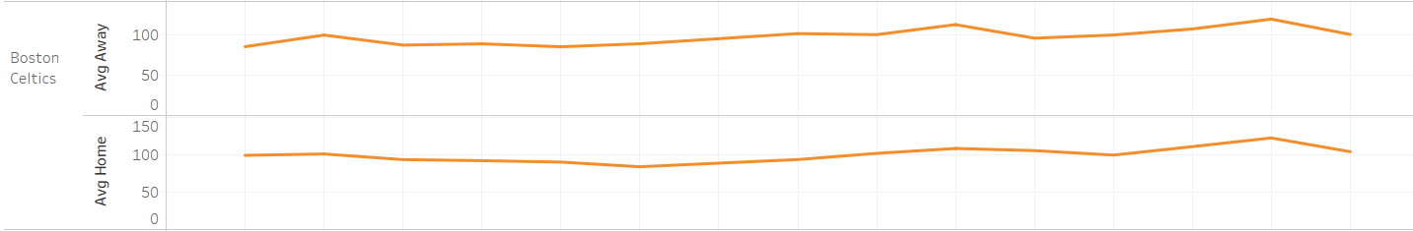
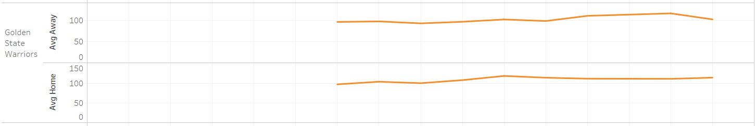
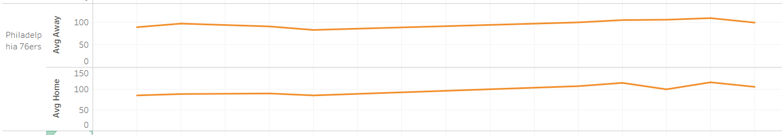
Visualization 9: Average Home and Away Scores vs Season

Slide 20
Conclusion

Slide 21
Appendix: Full Visualizations

Slide 22
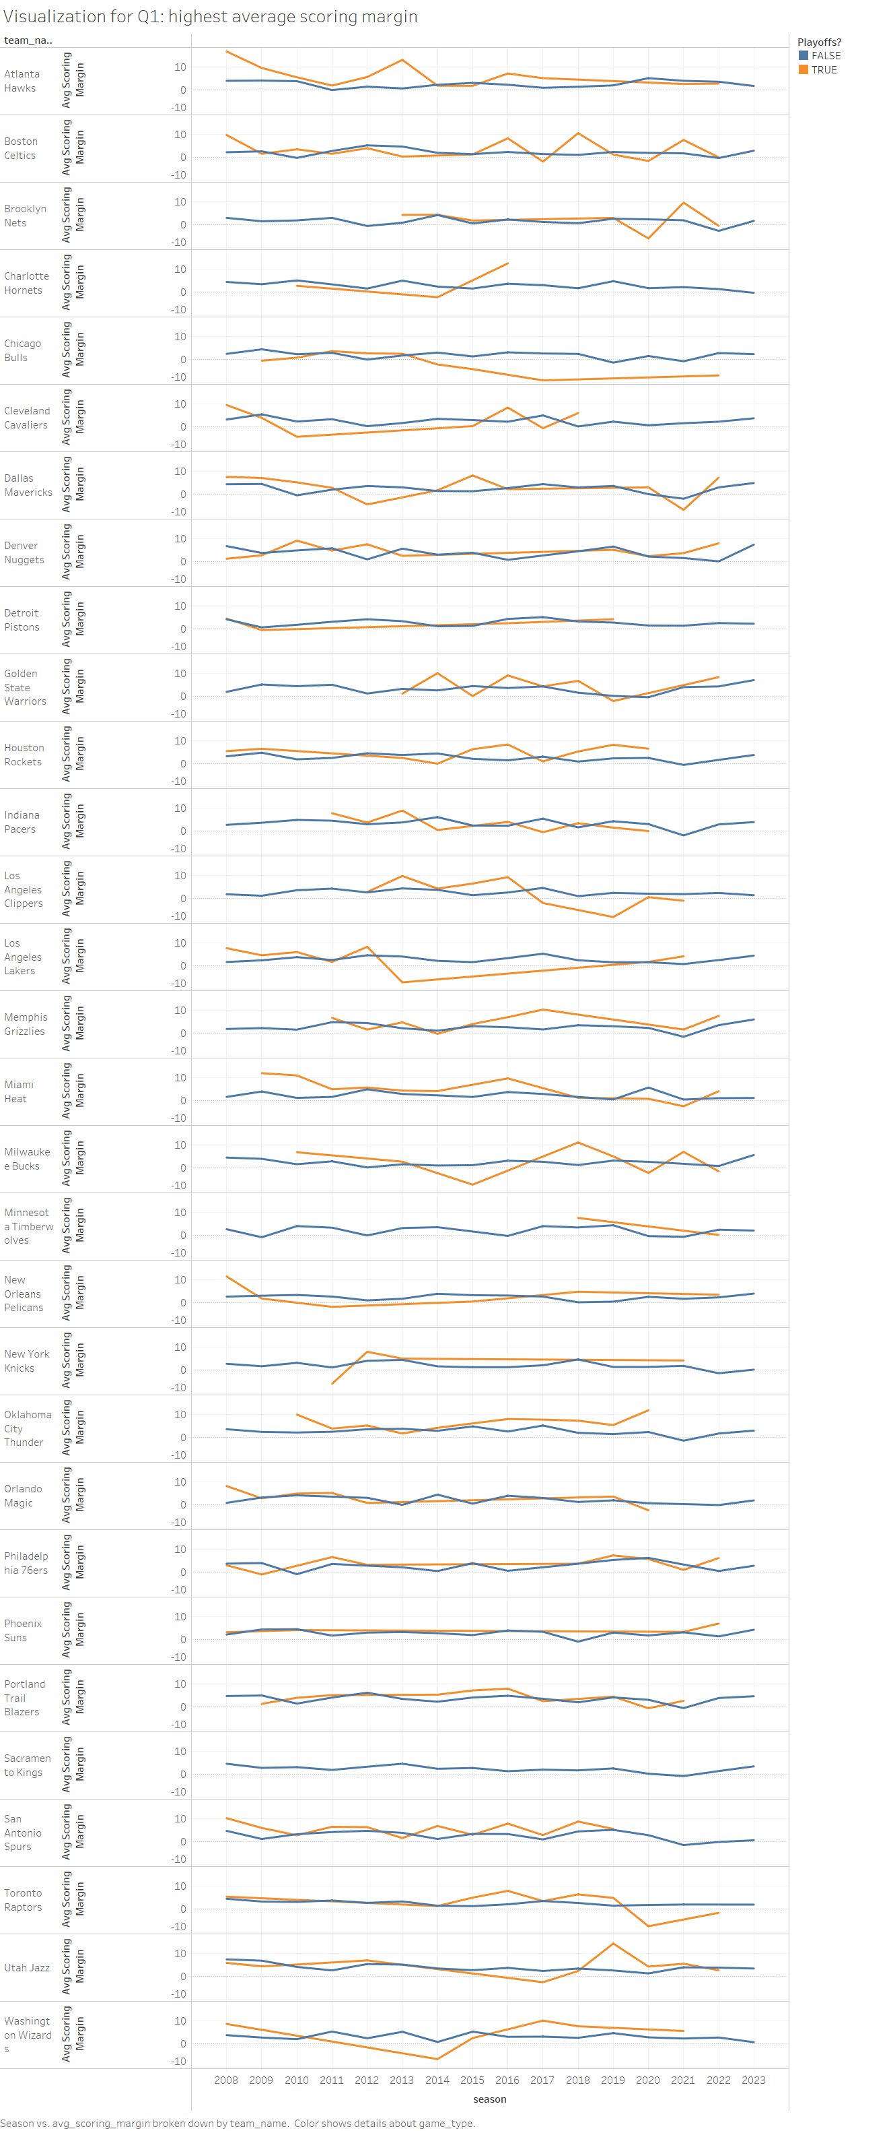

Slide 23
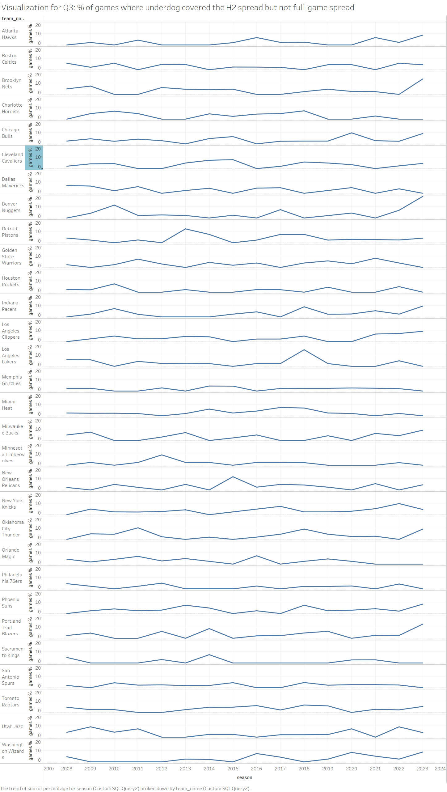

Slide 24
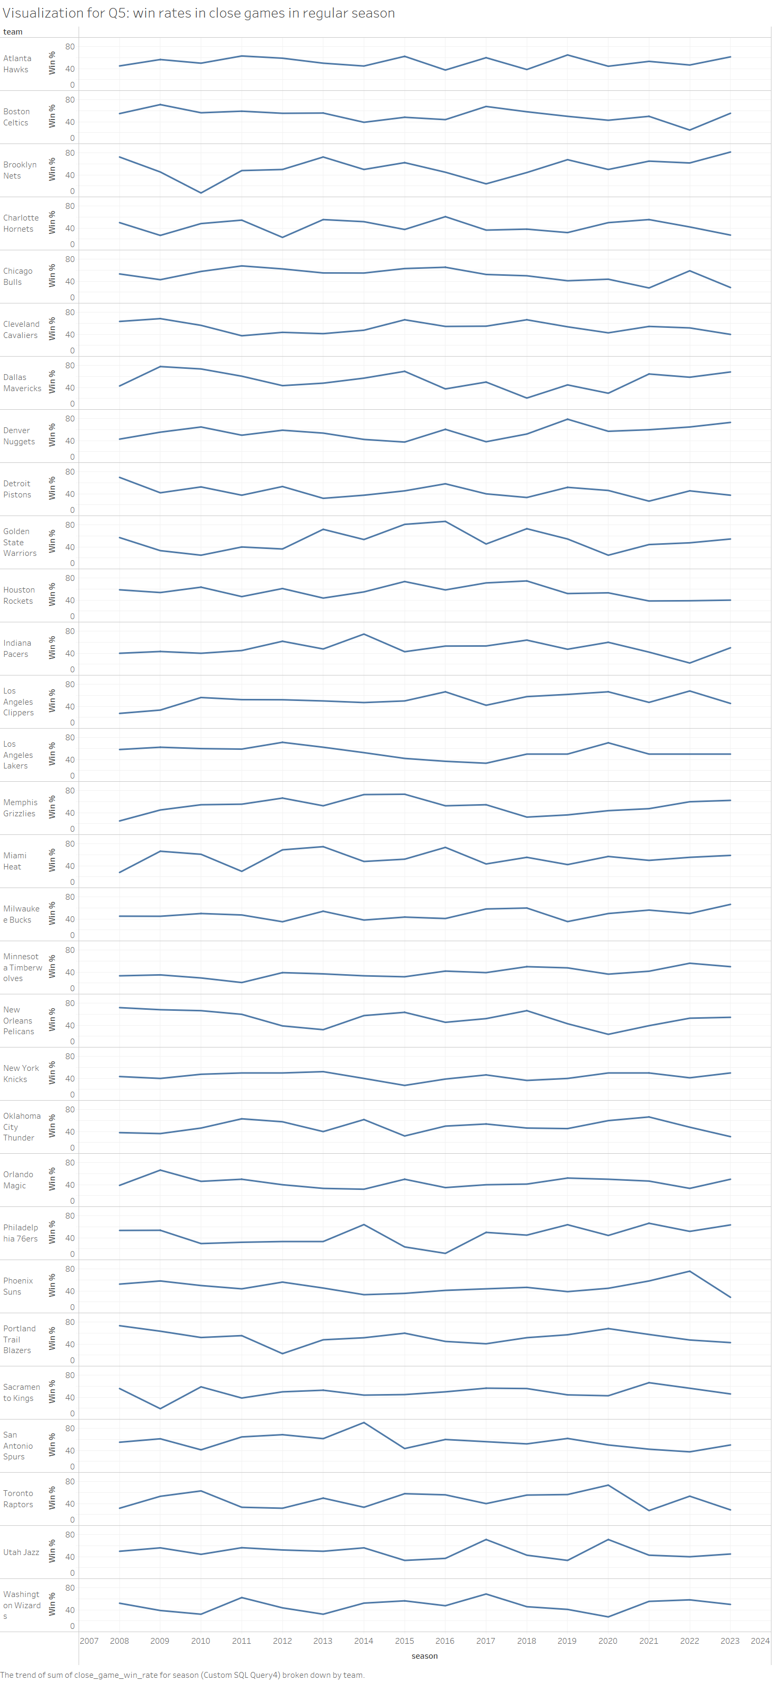

Slide 25
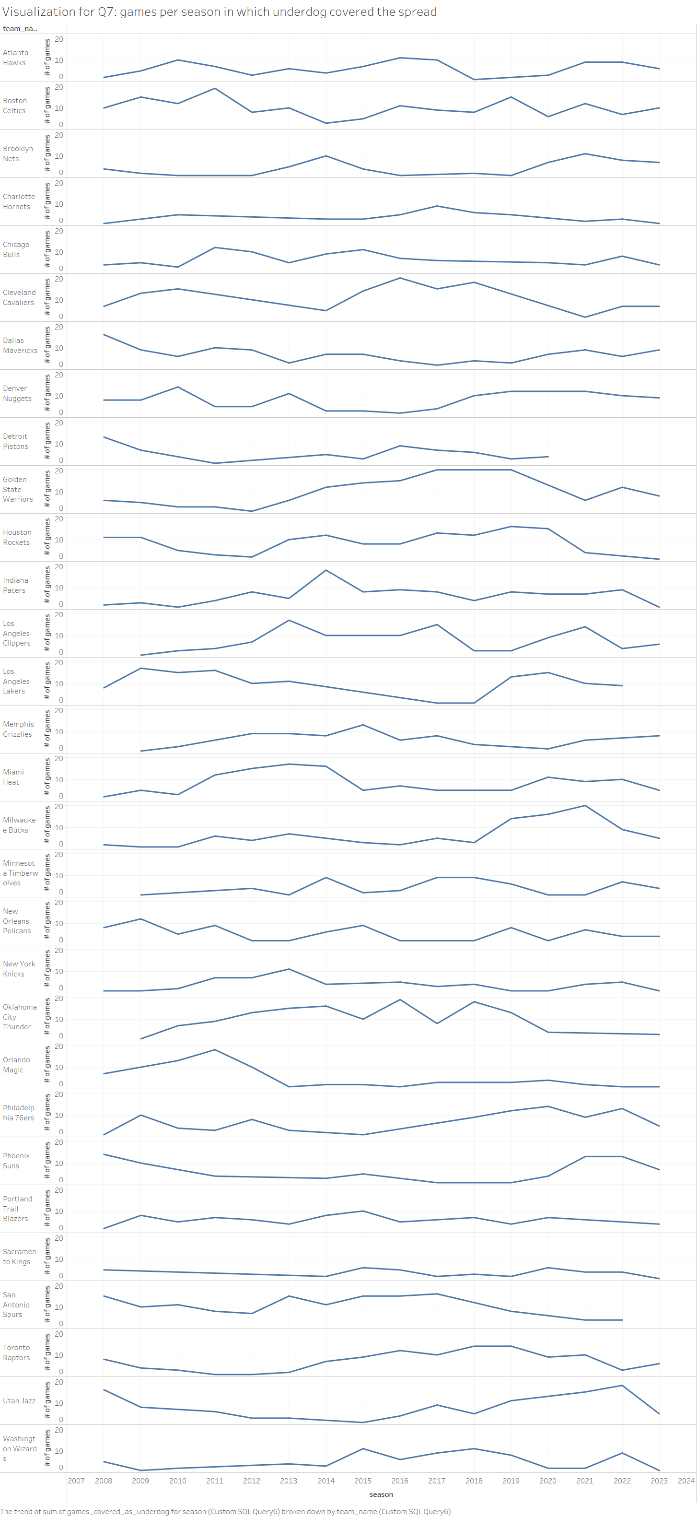

Slide 26
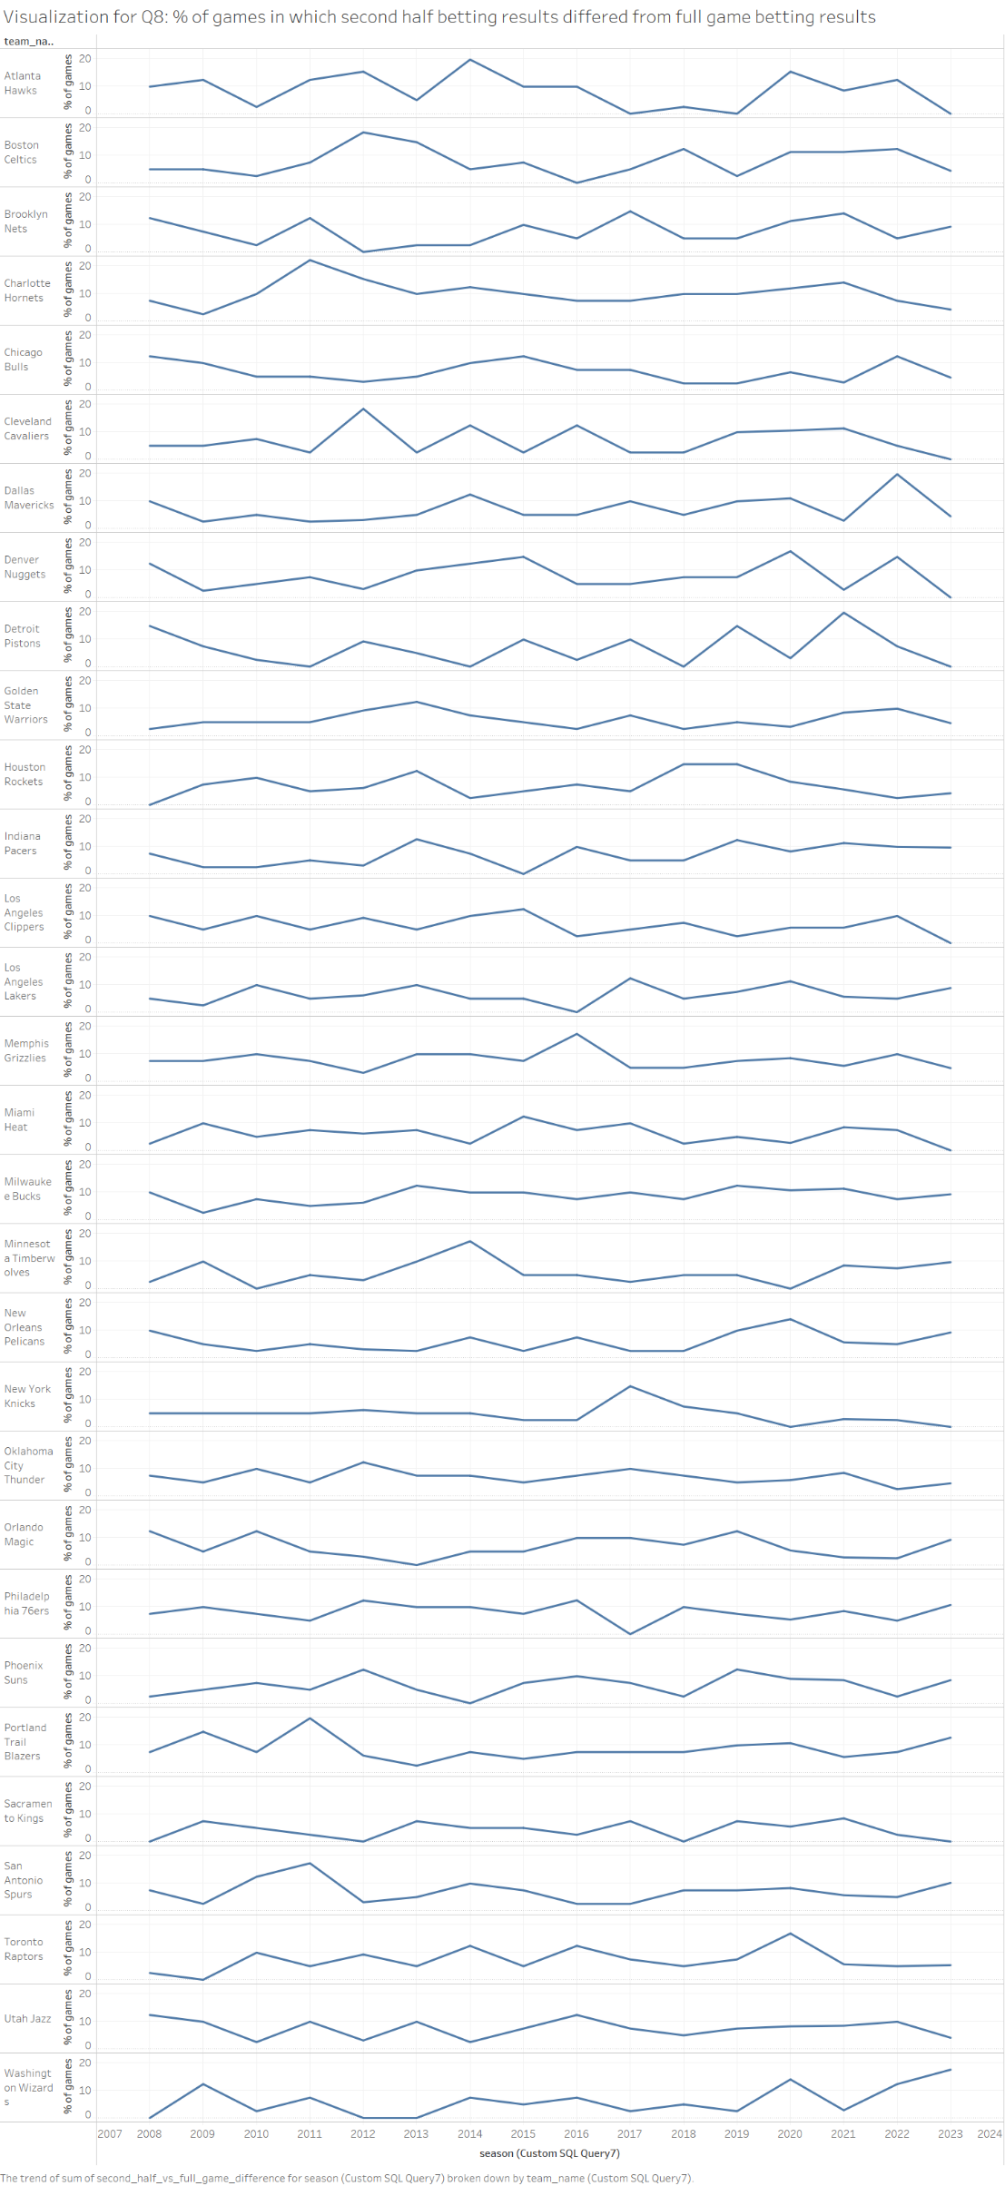

Slide 27
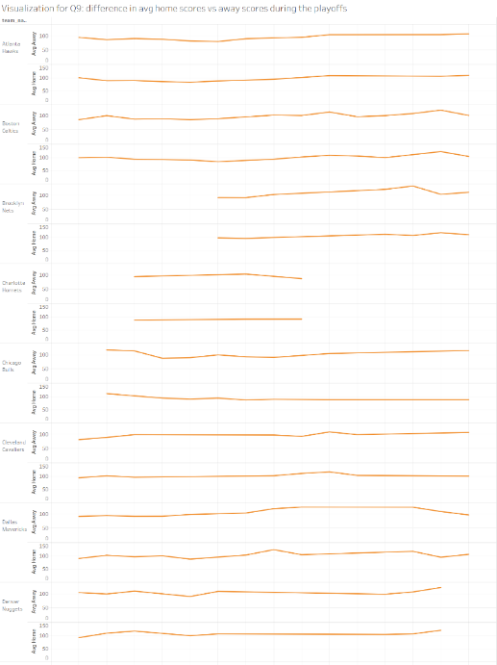
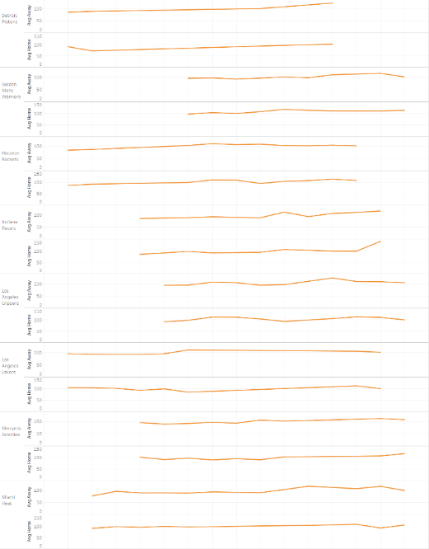

Slide 28
